Slide 1


Microsoft SQL Server Advanced Workshop
www.bairesdev.com

Slide 2

Agenda
Introduction
Basic concepts
Index Architecture
Storage Fundamentals
Fragmentation
Locking
Query Execution Plans
Advanced Query Techniques
Performance in Mission Critical Scenarios (OLTP)
Best Practices
www.bairesdev.com

Slide 3
Introduction: Who I am
A dreamer…
A guy who started coding by accident at the age of 10
Comes from a very poor family of European immigrants
One day, in July 1986…
Mom & Dad were given a nice gift for their kids: a Spectrum ZX80 (it’s a computer – don’t laugh on me haha!) ☺
Truth is we didn’t have any money for cartridges or things like that.
If I wanted to play a video game, I needed to code it. Over and over again.
That’s when I became a Computers Programmer → Sinclair BASIC on a ZX80, at the age of 10.
With the advent of the Commodore 16, Mom forced me to go to an institute; with the hope of a better future
Hence I did my best to learn RM COBOL → “Mom! writing COBOL code in a paper is not funny!”
A few years later, my parents managed to buy an IBM XT (2nd release of IBM PCs)
I started playing with a popular records manager called Btrieve - My first experience with ISAM flat files
Ashton-Tate releases DBASE 3, the first database engine for the IBM PC
The rest is a known story.
Advanced SQL Server
www.bairesdev.com

Slide 4









Introduction: What I do
A doer…
Software Developer at BairesDev
Part of a talented Software Development Team
A little gear -part of a bigger machine- who works with awesome people ☺
Primary Technical Contact of some Microsoft Partners in Canada
Technical advisor of some Microsoft Partners in the USA and LATAM
Member of the dev team who developed some Microsoft campaigns in LATAM
Some minor credentials
MCAD - Microsoft Certified Applications Developer (2006) MCP ID = 3767541
MCDBA - Microsoft Certified Database Administrator (2000) MCP ID = 1014129
MCSE - Microsoft Certified Systems Engineer (2000) MCP ID = 1014129
MCSD - Microsoft Certified Solutions Developer (2000) MCP ID = 1014129
Certificate of Excellence - Microsoft SQL Server 6.5 (1998) ← that was my first tiny certification! ☺
Advanced SQL Server
www.bairesdev.com

Slide 5













Introduction: What I do
I’m not a theorist - I come from the trenches instead.
…among others.
Shall we start?
Advanced SQL Server
www.bairesdev.com

Slide 6
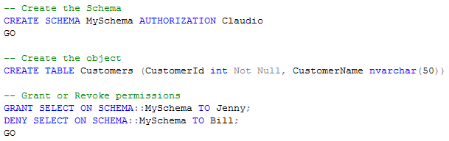
Intermediate concepts | Schemas
What is a Schema?
Simply put, a schema is a container of objects distinct from the user who created those objects.
You can assign a user login permissions to a single schema so that the user can only access the objects they are authorized to access
Where it comes from?
Before SQL Server 2005 objects were tied to the user who created them.
Example:
Claudio creates the customers table, so your SELECT looked like this → Select * From YourDB.Claudio.Customers
Jenny creates his own version of the table, so your SELECT looked like this → Select * From YourDB.Jenny.Customers
…and so on.
The user “Claudio” cannot be deleted without deleting the table or first transferring it to another user.
There was another drawback: something known as Permissions Chain (for the sake of brevity I won’t explain this)
With the advent of SCHEMAS, objects are no longer tied to the user creating them
Advanced SQL Server
www.bairesdev.com

Slide 7
Intermediate concepts | Cursors
What is a Cursor?
A Cursor is a SQL Server data type that allows you to loop through a collection of rows in a sequential manner.
They are typically slower because they only handle one record at a time.
More specifically, a cursor is a memory resident set of pointers (that’s why you need to “De-allocate” the cursor manually),
meaning it occupies memory from your system that may be available for other processes.
Poorly written cursors can completely deplete available memory
Advantages (if any)
No advantages, actually
Row-by-row operations
Quick and dirty way of processing data
Cursors can be replaced by a set of well-written
SQL statements
Disadvantages
Resources consumed by cursors
Memory and locks
Speed and performance issues
Number of rows and columns brought into the cursor
Cursor opening + sequential fetch
Wrong tool for the wrong task
They're used for quick-and-dirty programming when a developer does not have a good understanding of set operations
Subtle errors, if not coding horrors:
Failing to check the value of @@Fetch_Status
Improper indexes on the base tables
Too many columns being dragged around in memory
WHERE clause that brings too many rows into the cursor, which are subsequently filtered out by cursor logic
Advanced SQL Server
www.bairesdev.com

Slide 8
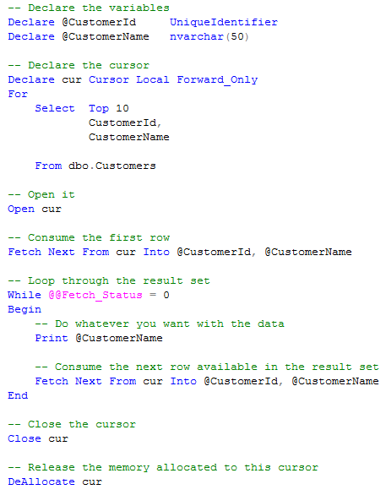
Intermediate concepts | Cursors
Cursor Example
This example is for educational purposes ONLY.
My technical recommendation is to avoid cursors,
with no exception.
Advanced SQL Server
www.bairesdev.com

Slide 9
Intermediate concepts | Temporary Tables vs. Table Variables
What is a Temporary Table?
Temporary tables are similar to permanent tables, except temporary tables are stored in TempDB and are deleted automatically when they are no longer used.
Types of Temporary Tables
There are two types of temporary tables: local and global. They differ from each other in their names, their visibility, and their availability:
Local Temporary Tables
They are visible only to the current connection for the user
They are deleted when the user disconnects from the instance of SQL Server
Example: #MyTable
Global Temporary Tables
They are visible to any user
They are deleted when all users referencing the table disconnect from the instance of SQL Server
Example: ##MyTable
Advanced SQL Server
www.bairesdev.com

Slide 10
Intermediate concepts | Temporary Tables vs. Table Variables
What is a Table variable?
Table variables are a special data type that can be used to store a result set for processing at a later time
When NOT to use them
Performance can be affected when very large table variables, or table variables in complex queries, are modified.
In these situations, consider using temporary tables instead.
Why?
Because Table variables are not supported in the SQL Server optimizer's cost-based reasoning model.
Therefore, they should not be used when cost-based choices are required to achieve an efficient query plan.
Temporary tables are preferred when cost-based choices are required.
Advanced SQL Server
www.bairesdev.com

Slide 11
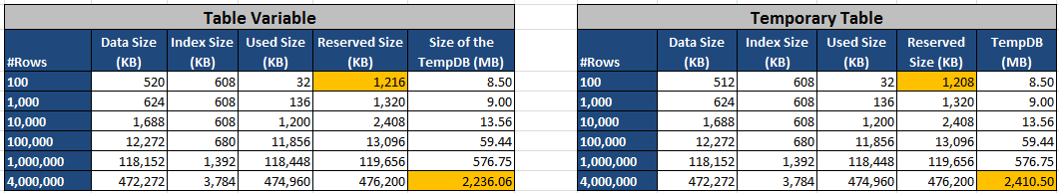
Intermediate concepts | Temporary Tables vs. Table Variables
Best Practice
Do not use table variables to store large amounts of data (more than 100 rows)
Plan choices may not be optimal or stable when a table variable contains a large amount of data.
Consider rewriting such queries to use temporary tables.
http://msdn.microsoft.com/en-us/library/ms175010(v=sql.105).aspx
(A > B) Higher space allocated in the lower boundary (few records)
(A < B) Lower space allocated in the upper boundary (tons of records)
In terms of space allocation, the numbers are nearly equivalent. Not a big difference
The interesting pattern is….
They differ in the upper and lower boundaries, specifically (100 records vs. 4 Million records)
(A > B vs. A < B)
Advanced SQL Server
www.bairesdev.com

Slide 12
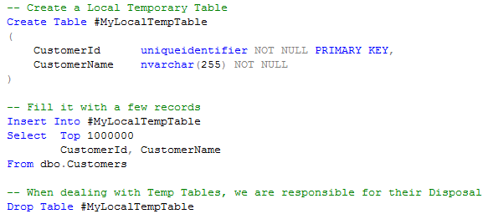
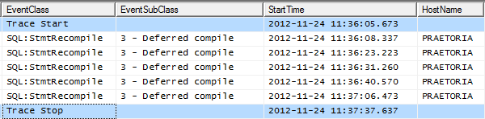
Intermediate concepts | Temporary Tables vs. Table Variables
Temporary Tables trigger statement recompiles more often
In addition, there’s a cost associated with the Temp Table disposal (the table is removed from TempDB)
Advanced SQL Server
www.bairesdev.com

Slide 13
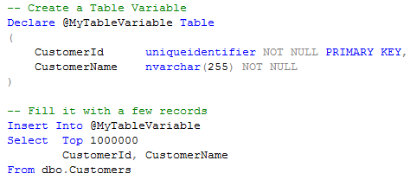

Intermediate concepts | Temporary Tables vs. Table Variables
Table variables trigger fewer recompiles than Temporary Tables
With SQL Server 2005+, recompilation now occurs at the individual statement level rather than stored procedure level.
This is advantageous because when input parameters change in a stored procedure the majority of the stored procedure can still utilize the cached execution plan. This known as partial usage (more on this later)
This is especially beneficial to stored procedures that contain many statements
Advanced SQL Server
www.bairesdev.com

Slide 14
Intermediate concepts | Temporary Tables vs. Table Variables
So what should I use? Table Variables or Temporary Tables?
The answer depends on these 3 factors:
The number of rows that are inserted to the table.
The number of recompilations the query is saved from.
The type of queries and their dependency on indexes and statistics for performance.
Advanced SQL Server
www.bairesdev.com

Slide 15
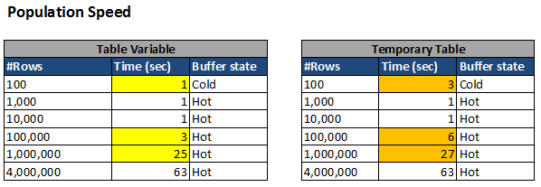
Intermediate concepts | Temporary Tables vs. Table Variables
Conclusions:
They are not the same thing
Prefer table variables whenever possible:
If you are dealing with a small amount of rows
Better performance, in general
Less locking
Less logging: Transaction rollbacks do not affect them
Tips:
Fewer recompilations as compared to temporary tables.
Well defined scope, at the end of which they are automatically cleared.
Transactions that involve table variables last only for the duration of an update on the table variable.
Therefore, table variables require less locking and logging resources.
Because table variables have limited scope and are not part of the persistent database,
transaction rollbacks do not affect them.
Table variables are always useful for small result sets → “small” means “less than 10K records”
If the result set returns a large number of records, we must consider whether a Temporary Table will give us a better throughput
More on this at:
http://support.microsoft.com/kb/305977?wa=wsignin1.0
http://support.microsoft.com/kb/243586
Advanced SQL Server
www.bairesdev.com

Slide 16
Intermediate concepts | Indexed Views
What’s an Indexed View?
Short Answer: It’s a “virtual” table. Nothing but a regular view + 4 major restrictions.
1) They have a Unique Clustered index (you must create such index manually)
Why? → see next slide
2) You must declare them with the attribute “SCHEMABINDING”
Why? → Because they are bound to the underlying schema.
This option prohibits the schema of the base tables from being changed
(adding or dropping a column, for instance).
To change the tables, the Indexed view must be dropped.
3) Your query is required to use a two-part syntax (example → schema.object)
Why? → Because of Ownership Chains (more on this later)
4) Your underlying query is confined to a limited set of statements
Why? → Because the definition of an indexed view must be deterministic, among other things.
Deterministic expressions always return the same result any time they are evaluated with a specific
set of input values. example → [D] DateAdd() vs. [ND] GetDate()
Advanced SQL Server
www.bairesdev.com

Slide 17
Intermediate concepts | Indexed Views
SQL Server treats such clustered index like any other clustered index.
That’s why an indexed view is a good candidate in terms of Query Plan resolution.
Scenario #1: Direct reference
Your query references the indexed view directly
Scenario #2: Engine decision
The query optimizer can select the indexed view if it determines that the view can be substituted
for some or all of the query in the lowest-cost query plan.
The indexed view is used instead of the underlying tables and their ordinary indexes, with the resulting performance gain.
Indexed views provide additional performance benefits that cannot be achieved using standard indexes.
Aggregations can be precomputed and stored in the index to minimize expensive computations during query execution.
Tables can be prejoined and the resulting data set stored.
Combinations of joins or aggregations can be stored.
Advanced SQL Server
www.bairesdev.com

Slide 18
Intermediate concepts | Indexed Views
Eligibility criteria performed by the engine
The tables in the query FROM clause must be a superset of the tables in the indexed view FROM clause.
The join conditions in the query must be a superset of the join conditions in the view.
The aggregate columns in the query must be derivable from a subset of the aggregate columns in the view.
All expressions in the query select list must be derivable from the view select list, or from the tables not included in the view definition.
One predicate subsumes another IF it matches a superset of the rows matched by the other.
For example, "T.a=10" subsumes "T.a=10 and T.b=20." Any predicate subsumes itself. The part of the predicate of the view that restricts values of one table must subsume the part of the predicate of the query that restricts the same table. Furthermore, it must do so in a way that SQL Server can verify.
Hands On →
Advanced SQL Server
www.bairesdev.com

Slide 19
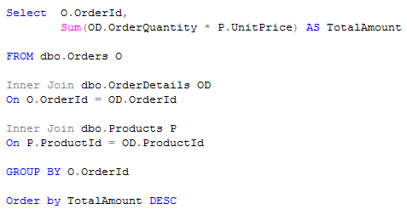
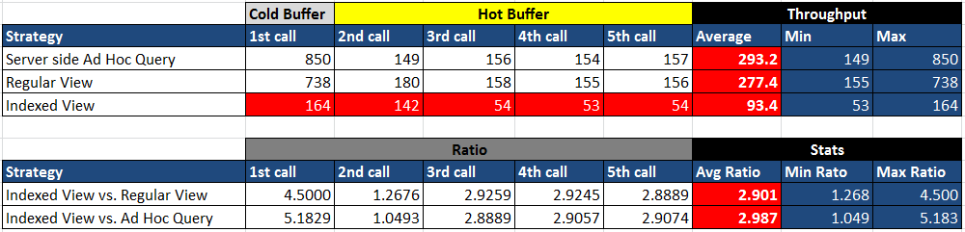
Views vs. Indexed Views
As per class exercise with a Very Large Database, we demonstrated that:
The indexed view results in a significant performance gain,
as per evidence below:
Advanced SQL Server
www.bairesdev.com

Slide 20
Views vs. Indexed Views
Benefits and liabilities
Large scale OLTP environments are less suitable for indexed views.
Works fine, if you know what you’re doing. No room for mistakes.
Mid-scale and low-scale OLTP environments are fine, as long as you do it carefully.
OLAP and isolated OLTP environments are perfect scenarios for an indexed view.
Advanced SQL Server
www.bairesdev.com

Slide 21

Turning up the heat
Hands ON, from now ON
Advanced SQL Server
www.bairesdev.com

Slide 22
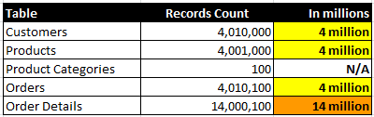
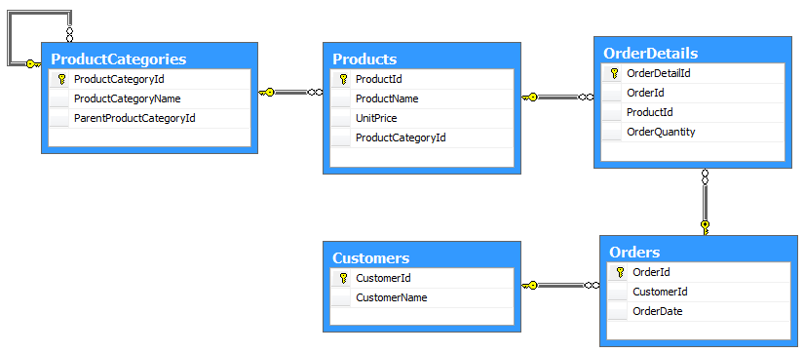
Views vs. Indexed Views
We want Millions of records
I come from the trenches, remember? ☺ lol
In real life, Mission Critical Applications use a VLDB (Very Large Database)
Our database will be populated with millions of records in order to replicate a large-scale scenario
Physical Implementation of our sample Model (ERD)
Advanced SQL Server
www.bairesdev.com

Slide 23
Index Internals
Types of Indexes
a) Clustered Indexes
b) Non-Clustered Indexes
Sub Types:
b.1) Unique Non-Clustered Indexes
b.2) Non-Unique Non-Clustered Indexes
b.3) Filtered Indexes (introduced in SQL 2008)
Advanced SQL Server
www.bairesdev.com

Slide 24
Index Internals | Structure of an Index
Prev
Next
Level n
Root Page
Index rows
B-Tree or
Non-Leaf Level(s)
1-n
Prev
Next
Prev
Next
Prev
Next
Intermediate
Index rows
Index rows
Index rows
Level 1
Prev
Next
Prev
Next
Prev
Next
Prev
Next
Prev
Next
Prev
Next
Leaf
Rows of Data
Rows of Data
Rows of Data
……
Rows of Data
Rows of Data
Rows of Data
Level 0
Advanced SQL Server
www.bairesdev.com

Slide 25
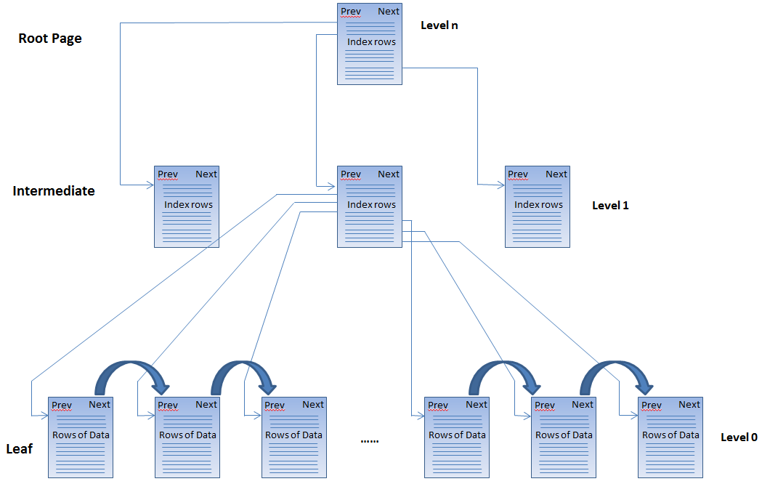
Index Internals | Structure of an Index
Every index has at least 2 levels:
One leaf-level, which contains the real data values
One or more Non-Leaf levels, used for internal navigation and transversal of the index structure
The upper portion of the index
is used for navigation only
The lower portion of the index contains the actual data.
Data is only returned from the Leaf level of the index.
SQL Server never uses information from the Intermediate or root levels to return data to the client
SQL Server numbers the levels from zero up to what whatever is the root level. This is called Index Depth.
The Root (Non-Leaf level “n”) is always 1 page wide.
Advanced SQL Server
www.bairesdev.com

Slide 26
Index Internals | Structure of an Index
Leaf Level
Contains something for every row of the table, in indexed order.
Non-Leaf Level(s) or Balanced-Tree
Contain the low value (plus a pointer) from every Page of the level below
A non-leaf level contains one entry for every PAGE of the level below
Low value
Advanced SQL Server
www.bairesdev.com

Slide 27
Index Internals | The Index creation process
Index creation is a 2 steps process
Step #1: Index Creation
Clustered Indexes: Physically order the data
Non-Clustered Indexes: Locally order the data
Step #2: Index Population
Add the B-Tree structure
Advanced SQL Server
www.bairesdev.com

Slide 28
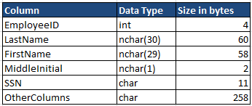


Index Internals | The Index creation process
Example. The “Employees” table → (Clustered Index scenario)
Structure of a Page
(more on this later)
Header (96 bytes)
Data row #1
Data row #2
Data row #3
Rows of Data
(8096 bytes)
Data row #4
20 rows per page
80,000 rows
4,000 pages
…
4,000 pages of Employees in clustering key order
Free space (if any)
The table gets physically ordered by the clustering key.
Clustered indexes have one row in sysindexes with indid = 1
4
3
2
1
Row offsets array
When a table is clustered the actual data becomes the leaf level of the clustered index.
1 – Claudio Romero
2 – Sir Isaac Newton
3 – Albert Einstein
…
20 – Alan Turing
21 – Amelia Earhart
22 – Edmond Halley
23 – John Nash
…
40 – James Maxwell
41 – Lord Kelvin
42 – John Locke
43 – Voltaire
…
60 – Michio Kaku
79941 – Rousseau
79442 – Lao Tzu
79443 – Machiavelli
…
79960 – Confucius
79961 – Napoleon
79962 – Alexander
79963 – Mozart
…
79980 – Beethoven
79981 – James Watt
79982 – Euclid
79983 – Archimedes
…
80000 – Faraday
…
File 1, Page 1
File 1, Page 2
File 1, Page 3
File 1, Page 3998
File 1, Page 3999
File 1, Page 4000
Advanced SQL Server
www.bairesdev.com

Slide 29
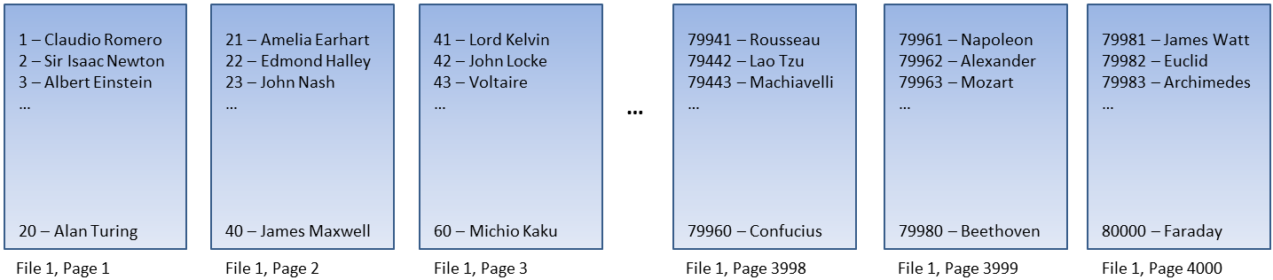
Index Internals | Structure of a B-Tree entry
B-tree entry =
Index key value
+
Page pointer
+
Row overhead
= 13 bytes
(4 bytes)
(6 bytes)
(3 bytes)
Index key (Employee ID)
File ID
Page ID
Overhead
Slot array
4 bytes
2 bytes
4 bytes
1 byte
2 bytes
(minimum)
Advanced SQL Server
www.bairesdev.com

Slide 30
Index Internals | The Index creation process
Now that we have the Leaf Level, all we need to do is to create the intermediate levels (non-leaf nodes)
until we end up with a root of 1 page
Steps:
1) Calculate the low value of each node
2) Compose the B-Tree entry
3) In the non-leaf level, create a new b-tree entry for every PAGE of the level below.
4) Repeat the steps 1-2-3 until you end up with a ROOT of 1 page.
A non-leaf level contains one entry for every PAGE of the level below
B-Tree entry
Index key + page pointer + overhead
Index Row
Index Row
Index Row
Non-Leaf
(Level 1)
Index Row
Index Row
Index Row
Index Row
Leaf
(Level 0)
Advanced SQL Server
www.bairesdev.com

Slide 31
Index Internals | The Index creation process
Steps:
1) Calculate the low value of each node
2) Compose the B-Tree entry
3) In the non-leaf level, create a new b-tree entry for every PAGE of the level below.
4) Repeat the steps 1-2-3 until you end up with a ROOT of 1 page.
Root
Index Row
Index Row
Non-Leaf
(Level 2)
Index Row
Index Row
B-Tree entry
Index key + page pointer + overhead
Index Row
Index Row
Index Row
Non-Leaf
(Level 1)
Index Row
Index Row
Index Row
Index Row
Leaf
(Level 0)
Advanced SQL Server
www.bairesdev.com

Slide 32
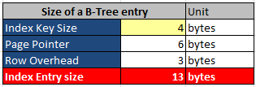


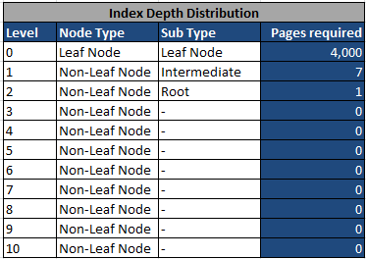
Index Internals | The Index creation process
Clustering Key
Advanced SQL Server
www.bairesdev.com

Slide 33
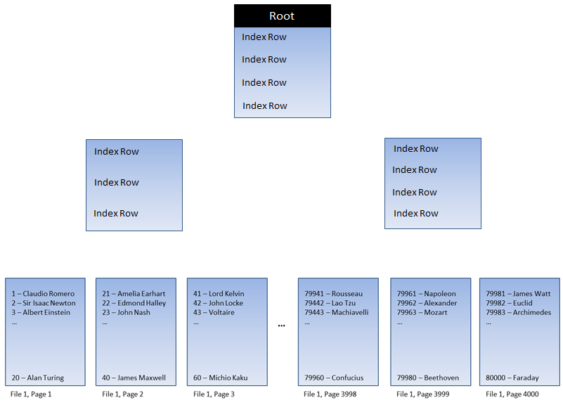
Index Internals | The Index creation process
Non-Leaf nodes
Usually available in memory
Usually available on disk
(we might have it in memory,
if the engine decides so)
Leaf nodes
Advanced SQL Server
www.bairesdev.com

Slide 34

Index Internals
Just to recap…
Composition
Every index has 2 levels (minimum):
1) One leaf-level, which contains the real data values.
They contain the actual data values.
The leaf level nodes are doubly linked with each other, in order to optimize Table Scans.
2) One or more Non-Leaf levels (which are used by the engine only) for transversal of the index structure.
Each index row contain a B-Tree entry that points to the LOW value of the PAGE below
Lookup speed and other benefits aside, this strategy is the very heart of SQL Server’s scalability.
Transversal and Retrieval
Non-Leaf nodes are usually available in memory, since they indicate “how to find” a specific record within a VLDB
Leaf Nodes are usually on disk, even though the engine might put them in memory, at his own convenience.
Advanced SQL Server
www.bairesdev.com

Slide 35
Storage Internals
What is a Heap?
A heap is a table with no Clustered Index defined on it.
A table that does not have a clustered index is referred to as a HEAP table.
A table that has a clustered index is referred to as a CLUSTERED table
Heaps
A Heap is an unstructured collection of Data Pages. Data is not stored in any particular order.
Any time you create a table with no Clustered Index you are creating a heap.
These tables have a index_id value of 0 in the sys.indexes catalog view
As soon as you define a Clustered Indexed on that table, you no longer have a heap.
You have a Data Record stored in the Leaf Level of the Clustered Index instead.
Hands On →
Advanced SQL Server
www.bairesdev.com

Slide 36
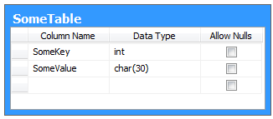
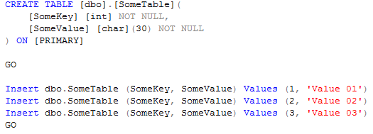

Storage Internals
Listing HEAPS
1) To start with, let’s create a Table with no Clustered Index defined on it
2) Heaps have a index_id value of “0” in the sys.indexes catalog view
Advanced SQL Server
www.bairesdev.com

Slide 37

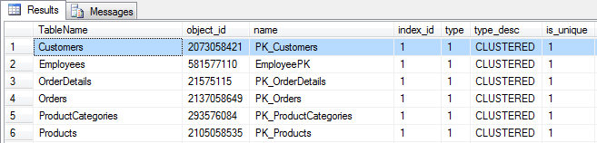
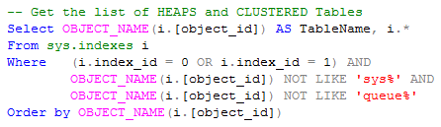
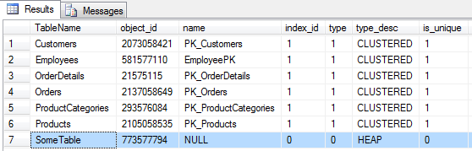
Storage Internals
Listing Clustered Tables
Clustered Tables have a index_id value of “1” in the sys.indexes catalog view
Listing both: HEAPS and Clustered Tables
Advanced SQL Server
www.bairesdev.com

Slide 38
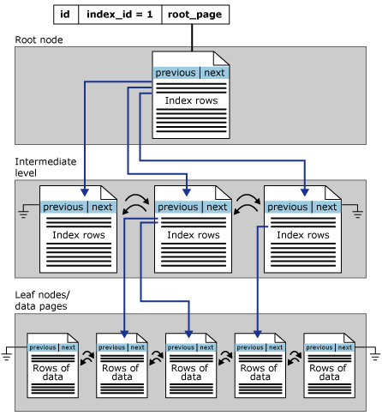
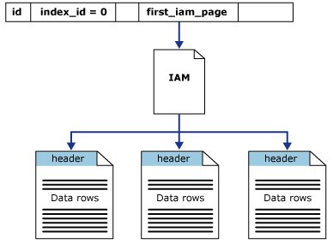
Storage Internals
HEAPS vs. Clustered Tables
Structure of a HEAP
vs.
Structure of a Clustered Index
Advanced SQL Server
www.bairesdev.com

Slide 39
Storage Internals | Record Types
Data Records
Primary Records
Forwarding record stubs
Forwarded record stubs
Index records
Leaf level index records
Non-Leaf level index records
Text records
LOB data
Row overflow data
Versioned Records - Out of scope (the versioning system is not covered in this workshop)
Used by the versioning system of SQL Server 2005+
They have a 14-bytes tag appended
Ghost Records
Advanced SQL Server
www.bairesdev.com

Slide 40
Record Types | Data Records
Data Records
Data records are stored on data pages
Data records store the value of every single column of the table row
Data records store rows from a heap OR the leaf level of a clustered index
Again:
Occur in heaps (tables without clustered indexes)
Occur at the Leaf Level of a clustered index
Hands On →
Advanced SQL Server
www.bairesdev.com

Slide 41


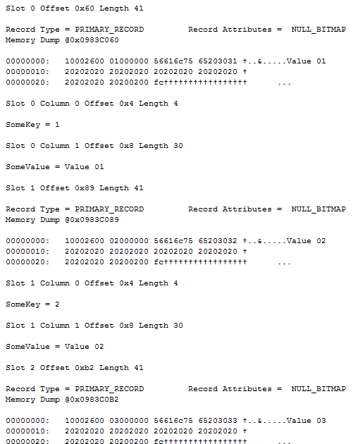
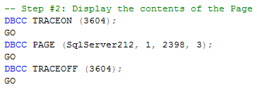
Record Types | Data Records
How can I see a “Data Record”?
Advanced SQL Server
www.bairesdev.com

Slide 42
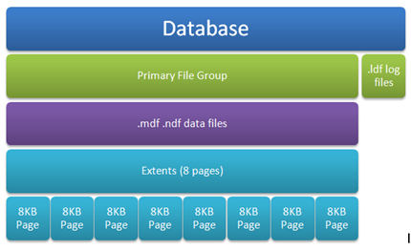

Inside a SQL Server Page
(0x60 = 96) 96 bytes of Header Offset
Data Records
(The 3 records we just created)
Advanced SQL Server
www.bairesdev.com

Slide 43
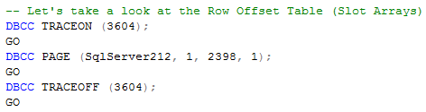
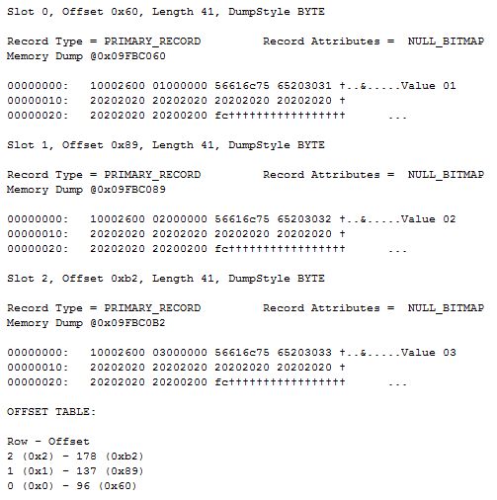
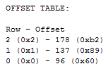
Inside the Slot Array (also known as Row Offset Table)
How can we see the Slot Array of a Table?
Position in the Slot Array (aka: “who am I?”)
Slot position = Row
Our table contains 3 rows:
Slot 0 = Pointer to the 1st row of the table
Slot 1 = Pointer to the 2nd row of the table
Slot 2 = Pointer to the 3rd row of the table
…and so on
Starting Offset of the Slot (aka: “where am I?”)
How far the first byte of the row is from the page.
In other terms, this is the Distance between the Page Header and a specific row.
Advanced SQL Server
www.bairesdev.com

Slide 44

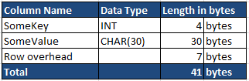
Inside the Slot Array (also known as Row Offset Table)
The “Starting bytes of a slot” tells how far the first byte of the row is from the page.
Row #1 (Slot #0) is 96 bytes (0x60) far from the start of the page, where 96 bytes is the page header size.
The “Starting bytes of slot” for subsequent rows are calculated as:
[Current Row Size] + [Previous Row Size]
Advanced SQL Server
www.bairesdev.com

Slide 45
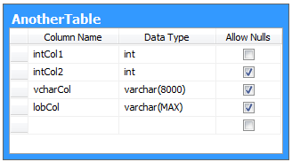
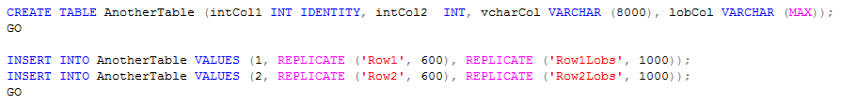
Record Types | Forwarding and Forwarded Records
Whenever a regular data record is updated to be larger, and there is no space on the page,
we are forcing SQL Server to move the record to a new data page.
The old location has a pointer to the new location:
The record in the new location is called a “forwarded” record
The record in the old location is called a “forwarding” record
Let’s create a table with variable-length columns
Hands On →
Advanced SQL Server
www.bairesdev.com

Slide 46

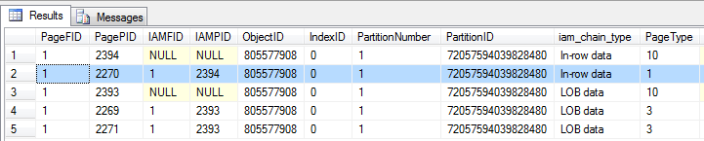
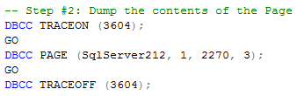
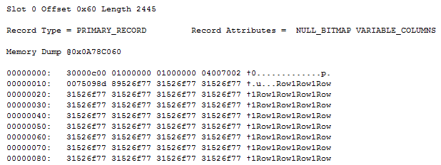
Record Types | Forwarding and Forwarded Records
The first row of our Table
is a regular data record, for now.
Advanced SQL Server
www.bairesdev.com

Slide 47
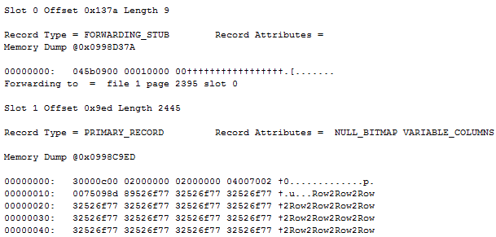
Record Types | Forwarding and Forwarded Records
Forcing the creation of a Forwarding Stub
Now we are going to update the first row to make it 8000+ bytes – forcing it to move to a new page.
Since the record won’t fit in the page, SQL Server will mark the original record as a Forwarding Stub.
Let’s take a look at the dump again…
Whoops!
Notice that our original data record was moved.
This is now a Forwarding Record.
Our original record is now stored in File 1, Page 2395
We didn’t update record #2, so it remains as a regular data record
Advanced SQL Server
www.bairesdev.com

Slide 48
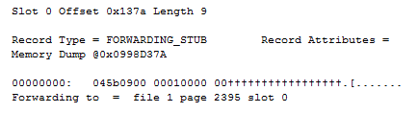
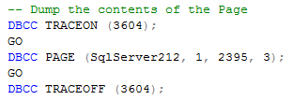
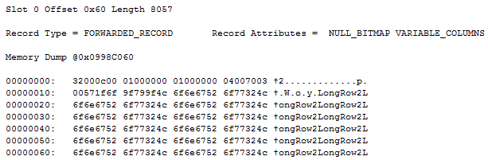
Record Types | Forwarding and Forwarded Records
Forwarding Record
Our original record is now stored in File 1, Page 2395
Forwarded Record
This is the record we updated.
The data record became a Forwarded Record.
The page was never moved, actually (doing so would lead to a performance issue).
Instead, SQL Server just updated something known as “TagA” → Byte 0 of the row – more specifically: bits 1, 2 and 3
Advanced SQL Server
www.bairesdev.com

Slide 49
Record Types | Index Records
What is an Index record?
Anytime you have a Non-Clustered Index you have index records
Index records are stored on index pages
Index records are marked as “Page Type = 2”
Two Types of Index Records:
Leaf Level index records
Occur in Non-Clustered indexes only – at the leaf level
Store all non-clustered index key columns plus:
A link to the matching row in the table
Any INCLUDED columns
Why they exist? → These records contain the real data of your Non-Clustered index
Non-Leaf Level index records
Occur in all index types – at the intermediate levels of the B-tree
Why they exist? → These records help the engine to transverse the index structure
Hands On →
Advanced SQL Server
www.bairesdev.com

Slide 50
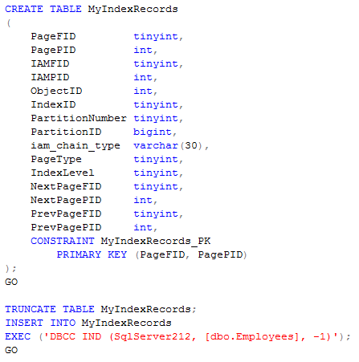

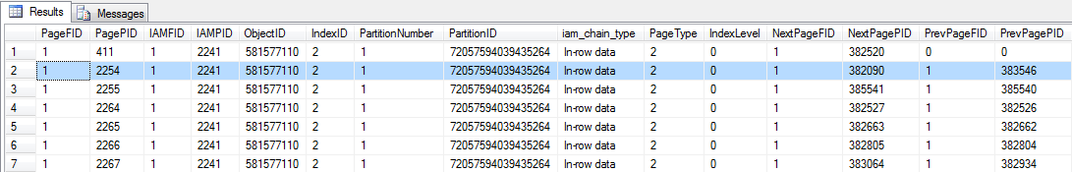
Record Types | Index Records
Create a table to store the output of the DBCC IND statement
Get the list of LEAF level index records
Advanced SQL Server
www.bairesdev.com

Slide 51
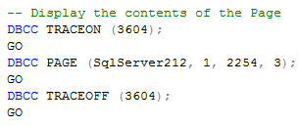
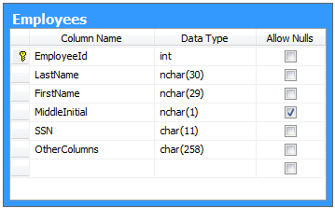
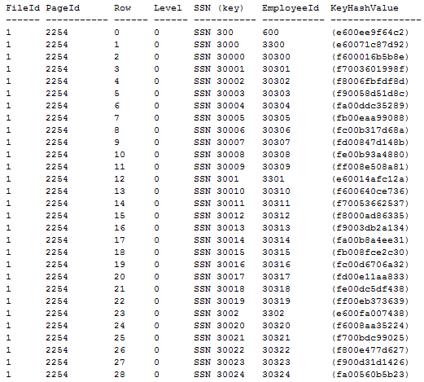
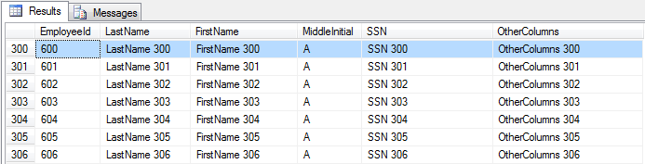
Record Types | Index Records
Dump of a Leaf Level index record
Non-Clustered index key
Advanced SQL Server
www.bairesdev.com

Slide 52

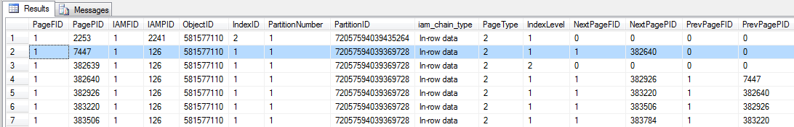
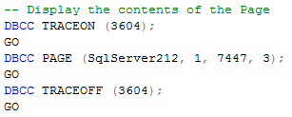
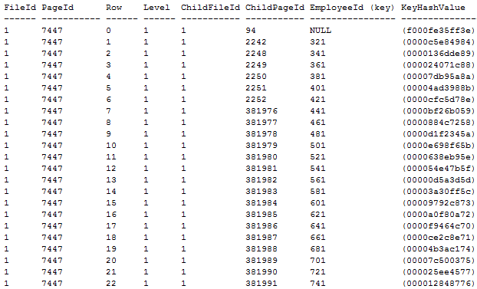
Record Types | Index Records
Non-Leaf Level Index Records
Get the list of Non-Leaf level index records
Advanced SQL Server
www.bairesdev.com

Slide 53

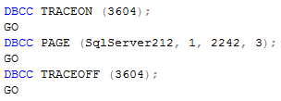

Record Types | Index Records
According to the B-Tree the employee #321 is located in File 1, Page 2242
Gotcha!
Advanced SQL Server
www.bairesdev.com

Slide 54
Record Types | Text Records
Text Records are used to store LOB (Large OBject) data and row-overflow data
LOB data is stored “off-row” by default
Row-overflow data is always stored “off-row”
The data record stores a pointer to the root of a loose tree structure that holds the LOB data in Text records.
Pointer to the root
LOB data
LOB data
Pointer to each child
Data Page
Text Page
Text Page
Text Page
Hands On →
Advanced SQL Server
www.bairesdev.com

Slide 55



Record Types | Text Records (example)
Examine the list of Pages
Data Page
Text Pages
These 2 pages contain the LOB data
Advanced SQL Server
www.bairesdev.com

Slide 56


Record Types | Text Records
The data record is located in page #2444
Dump of the page 2444
The TEXT data of this column is stored off-row
The data record stores a pointer to the root of a loose tree structure (known as YUKON ROOT) that holds the LOB data in text records.
Therefore the root node of the loose tree structure is located in File 1, Page 2443, Slot 0
Advanced SQL Server
www.bairesdev.com

Slide 57




Record Types | Text Records
So now we need to examine the Page #2443, which is the ROOT of the Tree
The first child of this node is located in page #2441
Advanced SQL Server
www.bairesdev.com

Slide 58
Record Types | Ghost Records
A ghost record is the result of a delete operation.
These are records that have been logically deleted but not physically deleted from a page.
Whenever you delete a record, SQL Server updates the bits 1-2-3 of byte 0 (record header) indicating it's a ghost record, and therefore it cannot be physically deleted until the transaction that caused it to be ghosted commits.
Once the transaction commits, two things could happen:
The ghost record is deleted by an asynchronous background process (called the ghost-cleanup task) OR
The ghost record is converted back to a real record by an insert of a record with the exact same set of keys.
What is their purpose?
Allowing delete or update operation run to faster and to ensure faster rollback if the transaction is cancelled.
The Ghost clean up
Deleting a record does not trigger a ghost-cleanup.
The ghost clean up is activated when the next scan operation reads the data page and notices that the page has ghost records.
Trace flag 661: Disable the ghost record removal process → http://support.microsoft.com/kb/920093
Hands On →
Advanced SQL Server
www.bairesdev.com

Slide 59



Record Types | Ghost Records
Deleting a record does not trigger a ghost-cleanup.
Advanced SQL Server
www.bairesdev.com

Slide 60


Record Types | Ghost Records
Viewing a Ghost Record (a “deleted” record)
This is the record we just deleted.
Notice it has been marked as “Ghost”
State of the “TagA” byte (byte 0 of the header)
Previous value of byte 0 = 0x10
0
0
0
1
0
0
0
0
New value of byte 0 = 0x1C
0
0
0
1
1
1
0
0
Advanced SQL Server
www.bairesdev.com

Slide 61
What is the Ghost Cleanup Task?
It’s a thread that physically removes the records that were marked for deletion.
More specifically, it’s a thread that periodically checks the B-trees for ghosted records, and asynchronously removes them from the leaf level of the index.
How it works?
The Ghost cleanup task divides the “ghost pages” into 2 categories:
Hot Pages (frequently visited by scanning processes)
Cold Pages
The thread wakes up every 5 seconds.
Its mission is to clean up a maximum of 10 ghost pages at a time
If the thread cleans up 10 hot ghost pages, it yields
What if there are more than 10 hot ghost pages?
If the number of hot ghost pages is greater than 10 then the thread will run non-stop until the count comes down
below the threshold value
If there is no CPU usage on the system, the Ghost cleanup task runs until there are no more ghost pages to clean up
CPU spikes? → http://support.microsoft.com/kb/978430
Hands On →
Advanced SQL Server
www.bairesdev.com

Slide 62


What is the Ghost Cleanup Task?
Trace flag 661 disables the ghost cleanup task. When this flag is on the Ghost cleanup task will not run.
Trace flag 662 along with 3605 redirects the output of the cleanup task to SQL Server error log
Monitor: SQL Profiler → select SQL Transaction → filter by Object Name like “GhostCleanupTask”
Advanced SQL Server
www.bairesdev.com

Slide 63

What is the Ghost Cleanup Task?
The 10 ghost pages
that were cleaned up
Advanced SQL Server
www.bairesdev.com

Slide 64
Storage Internals | Record Structure
All records have the same structure, regardless of their type and use.
The record structure is as follows:
Record header (4 bytes)
Fixed length portion of the record
NULL bitmap
Variable-length column offset array
Versioning tag
Null Bitmap Offset
Null Bitmap
A
B
Tag bytes
Fixed length portion of the record
Variable length
Column Offset Array
Variable length Columns
(Pointer to the end of each variable length column)
Advanced SQL Server
www.bairesdev.com

Slide 65
Storage Internals | Record Structure
Variable length
Column Offset Array
Variable length Columns
A
B
Byte 1 is the TagB byte of the record metadata.
It can either be 0×00 or 0×01.
If it is 0×01, that means the record type is ghost forwarded record.
Byte 0 is the TagA byte of the record metadata.
Bit 0 : Versioning information. In SQL server 2008 this is always 0
Bits 1-3 indicate the type of record:
0 = primary record - A data record in a heap that hasn't been forwarded or a data record at the leaf level of a clustered index.
1 = forwarded record
2 = forwarding record
3 = index record
4 = blob fragment
5 = ghost index record
6 = ghost data record
7 = ghost version record
Bit 4: Indicates whether a Null bitmap exists or not – (In SQL server 2008 null bitmap exists even if there is no null able columns)
Bit 5: Indicates whether the record contains variable length columns or not.
Bit 6: Indicates the row contains versioning information
Bit 7: Not used in SQL server
Advanced SQL Server
www.bairesdev.com

Slide 66
Storage Internals | Record Structure
Variable length
Column Offset Array
Variable length Columns
(4 bytes minimum – this varies)
A
B
Bytes 2 and 3 are the offset
of the NULL bitmap in the record
Bytes 8 and 9 are the count of columns in the record
Byte 10 is the NULL bitmap mask
Bytes 4 to 7 are the fixed length columns.
This is a 4-bytes Integer
This is the same value displayed in the pminlen field in the page header (DBCC)
Bytes 11-12-13-14 are the count of variable length columns in the record.
NULL bitmap entries point to the end of the column value.
This is done so that we know how long each column is without having to store their length as well
Advanced SQL Server
www.bairesdev.com

Slide 67
Storage Internals | Page Types
Data Pages
Store Data Records
They occur in a heap, or leaf-level of a Clustered Index
Index Pages
Store Index Records
Occur in Leaf level of Non-Clustered Indexes
Occur in Non-Leaf level of all index types
Text Pages
Store Text Records (off-row LOB values)
Text Tree
Used when values are larger than 8K
Text Mix
Used to store multiple values when they are less than 8K
Advanced SQL Server
www.bairesdev.com

Slide 68
Storage Internals | Page Types
Sort Pages
They are located in TempDB and they are used to support sort operations
They store intermediate results during a sort operation
Boot Pages
There is only ONE Boot Page per database. It is page 1:9
Stores base metadata about the database as a whole
File Header Pages
One per Data File, always the first page
Stores metadata about the data file(s)
Allocation Bitmaps
PFS, GAM, SGAM, IAM, DIFF_MAP, ML_MAP
Advanced SQL Server
www.bairesdev.com

Slide 69


Structure of a SQL Server Page
Advanced SQL Server
www.bairesdev.com

Slide 70


Data Page Restrictions
Fixed column length (IN_ROW_DATA)
Maximum = 8,060 bytes - as per SQL Server architecture
7 bytes of minimum row overhead
2 Bytes = Status Bits → TagA + TagB
2 Bytes = Offset to which the fixed data is stored
2 Bytes = Column count
1 Byte = NULL bitmap mask (minimum)
Net Payload = 8,053 bytes
Advanced SQL Server
www.bairesdev.com

Slide 71

Storage Internals | Extents
What is an “Extent”?
An extent is a collection of 8 contiguous pages.
8,192 bytes (8K) → 1 Page
8 Pages (64K) → 1 Extent
16 Extents → 1MB
What is their goal?
Primarily, they are intended to keep the database from becoming fragmented.
Fragmentation means that pages that belong together are scattered throughout the database file.
To prevent fragmentation, SQL Server assigns space to tables and indexes in Extents.
That way, at least 8 of the pages should be physically next to one another, making them easier for SQL Server to locate.
More info
Extents are always aligned on 64KB boundaries (i.e. 8-page boundaries), starting at the beginning of the file.
IAM, GAM and SGAM pages keep track of an Extent’s location
SQL Server databases have 16 extents per megabyte. → (16 * 8 Pages * 8KB = 1024KB = 1MB)
Why Extents exist?
They exist to make the Allocation sub-system more efficient - simple as that.
Types of Extents
Mixed extents
Dedicated (or uniform) extents
Advanced SQL Server
www.bairesdev.com

Slide 72
Storage Internals | Uniform Extents
When an Extent is occupied by a single object (for example: the “Customers” table) then it is called a “Uniform Extent”
Why?
Because the entire 64 KB of data is physically allocated to the “Customers” table.
Pictorial View of a Uniform Extent
The pages are physically arranged in a sequential manner, in 8K chunks – one after another
1 Extent = 64 Kilobytes
Page 1 (8K)
Page 2 (8K)
Page 3 (8K)
Page 4 (8K)
Page 5 (8K)
Page 6 (8K)
Page 7 (8K)
Page 8 (8K)
Customers
Customers
Customers
Customers
Customers
Customers
Customers
Customers
Uniform Extent
The 8 pages of the Extent are occupied by a single object.
Since the 8 pages are physically allocated in a sequential manner, we can read the data in chunks of 64K! Whooho! ☺
Advanced SQL Server
www.bairesdev.com

Slide 73
Storage Internals | Mixed Extents
When an Extent is occupied by multiple objects (two different Tables, for example) then it is called a “Mixed Extent”
Why?
Because the space represented by those 64 KB of data is “shared” by different objects.
That’s why a mixed extent is also known as “Shared Extent”
Pictorial View of a Mixed Extent
The Extent is “shared” by different objects
1 Extent = 64 Kilobytes
Page 1 (8K)
Page 2 (8K)
Page 3 (8K)
Page 4 (8K)
Page 5 (8K)
Page 6 (8K)
Page 7 (8K)
Page 8 (8K)
Orders
Customers
Orders
Customers
Orders
Customers
Employees
Employees
Hands On →
Advanced SQL Server
www.bairesdev.com

Slide 74

Storage Internals | Extents
Advanced SQL Server
www.bairesdev.com

Slide 75

Storage Internals | Uniform Extents
Extent #1
Extent #2
The Extent is occupied by 1 object ONLY
Advanced SQL Server
www.bairesdev.com

Slide 76


Storage Internals | Mixed Extents
The Extent is shared by these 2 tables
Advanced SQL Server
www.bairesdev.com

Slide 77


Storage Internals | Listing Extents
Mixed Extents
Records that can be physically deleted
Advanced SQL Server
www.bairesdev.com

Slide 78
Fragmentation
Fragmentation can be defined as any condition that leads to store data non-contiguously on disk
Optimal performance of SELECT queries occurs when the data pages of tables are contiguous and pages are fully packed as possible.
Fragmentation breaks this rule and reduce the performance of the queries.
Physical Disk Fragmentation
This occurs when the file system is not able allocate contiguous space for a file.
As a result, the disk head has to move back and forth to seek and read from the database files.
Placing your database files in the same disk where other files are kept (e.g. OS files, application files).
Frequent growth of the database file in smaller chunks.
How to avoid logical fragmentation?
Keep the database files in a separate disk, isolated from other application files and log files.
While creating a new database, estimate the size of the database file and allocate enough space
to avoid the frequent growth of data files.
Specify the database growth option to allocate larger chunks rather than small chunks frequently.
Advanced SQL Server
www.bairesdev.com

Slide 79



Index and Heap Level Fragmentation
Fragmentation occurs when there is non-contiguous unused space
in the index page
(Actually, it looks more like this)
The table records are physically stored in contiguous pages (chunks of 8KB)
vs.
There are 2 types of index level fragmentation:
Internal Fragmentation
External Fragmentation
Advanced SQL Server
www.bairesdev.com

Slide 80
Index Level Fragmentation
Internal Fragmentation
When records are stored non-contiguously inside the page, then it is called internal fragmentation.
In other terms, Internal fragmentation occurs when there is empty space in the index page
A page that is 100% full has no internal fragmentation.
Internal fragmentation is measured in average page fullness of the index (known as Page density).
Internal fragmentation is normally reported as a percentage of fullness in bytes, not in records.
Any DML statement produces fragmentation (INSERT / UPDATE / DELETE)
Page 50
Page 51
Page 52
INSERT
UPDATE
DELETE
…
Page 50
Page 51
Page 52
Unused space
Data
Data
Unused space
Data
Data
Data
..
INSERT
UPDATE
DELETE
…
Data
Unused space
Data
Unused space
Data
Data
Unused space
Internal Fragmentation will increase the I/O.
When you run queries that scan part or complete table/index, if you have internal fragmentation on that table/index, it causes additional page reads
Internal Fragmentation reduce the efficiency of buffer cache.
When indexes has internal fragmentation, it need more space to fit in the buffer.
Advanced SQL Server
www.bairesdev.com

Slide 81
Index Level Fragmentation
External Fragmentation
External Fragmentation happens when the logical order of the pages does not match the physical order of the pages
It is measured as the percentage of out-of-order pages in the leaf pages of an index
Insert Into MyTable (PkCol, OtherCols) Values ( , ‘Not enough space’)
3
SQL Server needs to move 4 records to a new page
Page 1 Prev Page: NULL Next Page: 4
Page 1 Prev Page: NULL Next Page: 2
1
2
3
1
2
4
5
6
7
Page 2 Prev Page: 4 Next Page: 3
Page 2 Prev Page: 1 Next Page: 3
8
9
10
11
12
13
8
9
10
11
12
13
Page 3 Prev Page: 2 Next Page: NULL
Page 3 Prev Page: 2 Next Page: NULL
14
15
16
14
15
16
Page 4 Prev Page: 1 Next Page: 2
4
5
6
7
Advanced SQL Server
www.bairesdev.com

Slide 82

Index Level Fragmentation
External Fragmentation
While reading individual rows, external fragmentation will not affect the performance as it directly go to the page and fetch the data
Unordered scans also will not affected by the external fragmentation, as it use the IAM pages to find which extents need to be fetched.
The degradation of the performance is because the disk drive's heads have to jump around on the physical disk (seek + read), rather than performing just contiguous read operations
Page 1 Prev Page: NULL Next Page: 4
1
2
3
When the extents of a table are not physically stored contiguously on disk, switching from one extent to another causes higher disk rotations
Page 2 Prev Page: 4 Next Page: 3
8
9
10
11
12
13
Page 3 Prev Page: 2 Next Page: NULL
14
15
16
Page 4 Prev Page: 1 Next Page: 2
4
5
6
7
Advanced SQL Server
www.bairesdev.com

Slide 83

SQL Pages → NTFS Clusters → Disk Sectors
SQL Server Page (8,192 bytes)
NTFS Cluster
NTFS Cluster
NTFS Cluster
NTFS Cluster
2 KB
2 KB
2 KB
2 KB
Size of the NTFS Allocation Units
Sector 80
Sector 81
Sector 82
…
Disk sectors
SQL Server Page (8,192 bytes)
NTFS Cluster
NTFS Cluster
4 KB
4 KB
Sector 80
Sector 81
Sector 82
…
Disk sectors
Advanced SQL Server
www.bairesdev.com

Slide 84


How to detect Fragmentation?
Fragmentation information is available through the view “dm_db_index_physical_stats”
To measure External Fragmentation → see avg_fragmentation_in_percent
The lower this value is, the better
To measure Internal Fragmentation → see avg_page_space_used_in_percent
The higher this value is, the better
The percent of logical fragmentation
(out-of-order pages in the index)
Average percentage of available data storage space used in all pages
The Customers Table is heavily fragmented
External Fragmentation Detected!
The leaf level of the Customers Table is fragmented.
As you can see, the first non-leaf level is also fragmented.
Internal Fragmentation Detected!
The root of the index is fragmented
The non-leaf page below the root is also fragmented
Advanced SQL Server
www.bairesdev.com

Slide 85
How to reduce Fragmentation?
How to reduce Fragmentation of a Heap
Best practice:
Create a Clustered Index. Period.
Bad Practice:
Another alternative to reduce fragmentation of a heap is to create a clustered index on the table, only for the purpose of de-fragmenting the Heap, and drop it afterwards
Creating the clustered index will rearrange the records in physical order (the pages will be stored contiguously on disk)
How to reduce Fragmentation of an Index
Depending on the percentage of fragmentation…
avg_fragmentation_in_percent | Corrective Action | SQL Statement
Less than 5% logical fragmentation | No action required | N/A
between 5% and 30% logical fragmentation | Reorganize the index | ALTER INDEX REORGANIZE
more than 30% logical fragmentation | Rebuild the index | ALTER INDEX REBUILD
These threshold values (5% - 30%) are made up. They can and will vary for you.
They are more like a guideline, a starting point.
Advanced SQL Server
www.bairesdev.com

Slide 86



How to reduce Fragmentation?
Index rebuilds depend on stats, which are updated by index rebuilds (huh?!?!?!)
Rebuilding an index updates the statistics, but if the statistics aren't up-to-date
then the index rebuild might parallelize badly
Therefore, you should Update the Database statistics first, and then rebuild/reorganize the indexes.
Option #1: Reorganize the index
Option #2: Rebuild the index
Hands On →
Advanced SQL Server
www.bairesdev.com

Slide 87


Locking and Blocking
Historically, the x86 family of microprocessors was conceived to deal with a single “core” in mind.
Following Moore’s Law, transistor density (or the number of transistors which can be placed on an integrated circuit) have consistently doubled every 2 years since the development of the first general purpose single chip CPU in 1971.
By 2013 we use parallel CPUs and multiple cores.
Intel Nehalem CPU architecture accommodates up to 8 cores per CPU, which when used in an 8 socket system can then be doubled to 128 logical processors through the use of hyper-threading technology.
As the number of logical processors on x86 compatible computers increases →
so too does the possibility that concurrency related issues may occur →
when logical processors compete for resources
More processors
More parallelism and concurrency
Competing for the same resource
Threads
Threads
Threads
Threads
Advanced SQL Server
www.bairesdev.com

Slide 88



Locking | Spinlock Contention
What is a Spinlock?
Spinlocks are lightweight synchronization primitives which are used to protect access to data structures in the engine.
When a thread attempting to acquire a spinlock is unable to obtain access it executes in a loop periodically checking to determine if the resource is available instead of immediately yielding
SQL Server utilizes spinlocks to protect access to some of its internal data structures
What is a Back off?
After some period of time, a thread waiting on a spinlock will yield before it is able to acquire the resource in order to allow other threads running on the same CPU to execute.
This is known as a thread back-off
How it works
1. Thread #1 acquires a spinlock on a given data structure
Thread #1
Data structure
3. The data structure is locked by Thread #1
2. Thread #2 attempts to acquire a spinlock on the same data structure
4. Rather than yielding immediately,
Thread #2 will “spin” (execute a loop) for a period of time, checking if the resource is available.
Thread #2
5. If the spin limit is reached the thread will “back off”
Advanced SQL Server
www.bairesdev.com

Slide 89

Locking | Spinlock Contention
On any busy high concurrency system it is normal to see active contention on frequently accessed structures that are protected by spinlocks.
This becomes an issue when the contention is such that it introduces significant CPU overhead
Back offs
Occurs when a “spinning” thread that is attempting to access a held resource has determined that it needs to allow other threads on the same CPU to execute
Sleep Time
This is an aggregate of how much time is spent sleeping between spin cycles when a back off occurs.
Spins per Collision
Ratio of spins per collision.
Spins
This value is incremented for each time a thread executes a loop while waiting for a spinlock to become available.
This is a measure of the amount of work a thread does while it is trying to acquire a resource
Collisions
This value is incremented each time a thread attempts to access a resource which is protected by a spinlock and is blocked because another thread currently holds the spinlock
Advanced SQL Server
www.bairesdev.com

Slide 90

Locking | Spinlock Contention
The algorithm
Attempt to acquire a lock
If the lock attempt fails then…
Spin Algorithm
1. Determine how long to “spin”
Either a constant or exponentially increasing value
2. Spin for the specified length of time
Each loop increments the “Spins” counter
3. Check for lock ownership
(not to confuse with “the attempt to acquire”)
4. If the Spinlock is no longer owned by a thread then stop spinning
5. If the spin limit reached then stop spinning and execute the back off
Collision
Increment the Performance Monitor collisions counter
Execute the spin algorithm
If the Spinlock is no longer owned by a thread then attempt to acquire a lock
If unable to acquire a lock then repeat Spin Algorithm
Back Off Algorithm
If spin limit reached then initiate back off (sleep)
Repeat the Spin Logic after the back off interval
Advanced SQL Server
www.bairesdev.com

Slide 91
Locking | Spinlock Contention
Typical Symptoms
The symptom primarily associated with spinlock contention is high CPU consumption, as a result of the large number of spins and many threads attempting to acquire the same spinlock.
In heavy CPU scenarios one may also observe high signal waits on SOS_SCHEDULER_YEILD (reported by the DMV sys.dm_os_wait_stats).
The system is experiencing very high concurrency
The CPU usage and spins are increased disproportionate to throughput
Some of the more common causes for increased CPU consumption include:
Queries which become more expensive over time due to growth of the underlying data resulting in the need
to perform additional logical reads of memory resident data
Changes in query plans resulting in suboptimal execution
Hands On →
Advanced SQL Server
www.bairesdev.com

Slide 92


Locking | Shared Database Locks
Shared Database locks
On connect, SQL Server allows access to the database and gives a Shared Database lock to the connection
A Shared Database lock prevents other people from doing operations on the database that would require the DB to be in Single User Mode, without forcing your particular connection to be dropped
In other terms, prevents other people from altering the Database State (e.g. EMERGENCY, OFFLINE)
S
Intent eXclusive locks
Imagine the user submitting a query to modify a few rows:
IX
To perform the database update SQL Server needs to first access the table and lock it with an IX (Intent eXclusive) lock
To be able to take row-level exclusive locks you must also take Intent Exclusive locks at the page level
“I’m not exclusively locking this page but I intend to take row locks”
Second, SQL Server needs to find the page on which the row(s) exist and lock them with IX locks.
If an index exists it can speed the request and limit the number of pages accessed.
Finally, an exclusive lock is acquired on the row(s) that need to be modified.
Advanced SQL Server
www.bairesdev.com

Slide 93
Locking | Lock Hierarchy
The basic lock hierarchy in SQL Server is always top-down.
Locks always have to be acquired top-down. Otherwise a deadlock situation may take place
Database
S
Table
Database level
IX
Page
IX
Page Header
Table level
Row
Page Header
Row
Row
Row
Page Header
Row
Row
Row
Page Header
Row
Page level
Row
Row
Page Header
Row
Row
Row
Row level
Row
X
Row
Row
Advanced SQL Server
www.bairesdev.com

Slide 94
Locking | Row Locks
Shared Locks are read locks held until the resource has been read and processed.
These locks are released almost immediately.
“You can read a particular resource, but you cannot modify it”
Update Locks – Reading with the intent to modify but has not yet modified. Allows better concurrency
They are acquired at the beginning of the statement to isolate all of the needed rows to guarantee a consistent starting point.
“I intend to go and do an update at some point, but I’m taking an Update Lock to allow concurrent readers with Shared Locks to read the data.
As soon as I modify the data, upgrade me to an Exclusive Lock”
eXclusive Locks – Has made a modification and the transaction is still pending
They are held for writers once the transaction has modified the data
These locks are not released until the transaction completes (commit or rollback)
“You are modifying that data so the exclusive lock will be held until you are done“
Lock compatibility matrix
Lock held
 | Shared | Update | eXclusive
Shared | Granted | Granted | Wait
Update | Granted | Wait | Wait
eXclusive | Wait | Wait | Wait
Process #1 holds an exclusive lock on a given resource
Lock requested
Process #2 attempts to acquire a lock a Shared lock on the resource locked by Process #1
Advanced SQL Server
www.bairesdev.com

Slide 95
Locking | Intent Locks
Why they exist?
Intent locks exist to prevent non-compatible locks from being taken.
They represent an “intention”, giving SQL Server an idea on what you are planning to do.
Intent locks improve performance because SQL Server examines intent locks only at the table level to determine
if a transaction can safely acquire a lock on that table.
This removes the requirement to examine every row or page lock on the table to determine if a transaction can lock the entire table
Types of Intent locks
Shared – only readers on the table
Intent Shared – reader with a shared page or row level lock at a lower granularity
Indicates the intention of a transaction to read some (but not all) resources lower in the hierarchy by placing Shared locks
on those individual resources.
Intent Exclusive – writer with an exclusive page or row level lock at a lower granularity
Indicates the intention of a transaction to modify some (but not all) resources lower in the hierarchy by placing Exclusive locks
on those individual resources.
Exclusive – only one writer on the table
Shared with intent exclusive (SIX) - Indicates the intention of the transaction to read all of the resources lower in the hierarchy and modify some (but not all) resources lower in the hierarchy by placing IX locks on those individual resources.
Exclusive
Intent Exclusive
Intent Shared
Shared
Not compatible
Compatible
Compatible
Not compatible

Slide 96

Locking | Lock Escalation
Lock Granularity
Lock granularity is determined at query compilation time
Row/Page level locking
Partition level locking
Table level locking
Lock Escalation
Long story short, lock escalation happens when SQL Server determines that you are holding too many locks.
Fact: Every lock takes up some memory. The lock escalation threshold is 5,000 locks
Behavior: If your query acquires too many locks (aka: you are taking up too much memory)
SQL Server says:
“Hey buddy! Your query is holding 5,000 locks - which is the lock escalation threshold.
That’s too many locks and you are taking up too much memory,
so we are going to switch to a Table Level lock”
Lock Escalation is triggered when…
Lock escalation is not disabled on the table by using the ALTER TABLE SET LOCK_ESCALATION option AND
When either of the following conditions exist:
The number of locks in an instance of the Database Engine exceeds memory or configuration thresholds.
A single Transact-SQL statement acquires at least 5,000 locks on a single non-partitioned table or index.
A single Transact-SQL statement acquires at least 5,000 locks on a single partition of a partitioned table and the ALTER TABLE SET LOCK_ESCALATION option is set to AUTO.
If locks cannot be escalated because of lock conflicts, the Database Engine periodically triggers lock escalation at every 1,250 new locks acquired.
Advanced SQL Server
www.bairesdev.com

Slide 97
Locking | Lock Escalation
Lock Escalation
“Hey buddy! Your query is holding 5,000 locks - which is the lock escalation threshold.
That’s too many locks and you are taking up too much memory, so we are going to switch to a Table Level lock”
The Table Level lock (whether Exclusive or Shared) will be queued up when it is acquired,
whereas all of the other lower level locks will be dropped in order to preserve memory resources
(aka: use less lock memory)
Lock Escalation always go from Row to Table or Page to Table (depending on the case)
Changing the way Lock Escalation works (SQL Server 2005 to 2012)
http://msdn.microsoft.com/en-us/library/ms188396.aspx
Trace Flag #1224
Disables lock escalation until 40% of memory is used and then re-enables escalation
If you want Lock Escalation to only happen when there is heavy memory pressure on the system then use Trace Flag #1224
Trace Flag #1211
Disables lock escalation totally and will allow lock memory to grow to 60% of dynamically allocated memory.
Further locking will fail with an out-of-memory error
The SQL Server Database Engine will not escalate row or page locks to table locks.
This flag helps to avoid the "out-of-locks" error when too many locks are being used.
However, because trace flag #1211 prevents escalation in every case (even under memory pressure) Microsoft still recommends that you use Trace Flag #1224
The problem with these two trace flags are that they are instance-wide and turning them on can cause huge performance issues
if a poorly-written application takes too many locks
Advanced SQL Server
www.bairesdev.com

Slide 98

Locking | Lock Escalation
Just to recap…
Why it happens?
It happens because your SQL statement acquired too many locks, resulting in an excessive memory consumption as well as
preventing other threads to execute.
When it happens?
Other than a few exceptions, it usually happens when your poorly-written application acquires too many locks
and SQL Server decides to take a lock higher in the hierarchy, in order to save lock memory:
You exceeded the default lock escalation threshold (5,000 locks)
Your query takes up 40% of the dynamically allocated server memory - if trace flag #1224 is activated
Your query takes up 60% of the dynamically allocated server memory - if trace flag #1211 is activated
To detecting blocking see…
Hands On →
Advanced SQL Server
www.bairesdev.com

Slide 99
Locking | Deadlocks
In simple terms, a deadlock happens when two (or more) transactions request mutually desired resources in an undesirable order.
(T1) Transaction 1
T1 locks Table1.rowX
T1 requests a lock on Table2.row6
Timeline
T2 locks Table2.row6
T2 requests a lock on Table1.rowX
(T2) Transaction 2
Deadlock
This creates a DEAD lock (aka: “a circular reference”), which is infinite.
SQL Server detects and resolves the deadlock by choosing a victim.
Live Lock
This creates a LIVE lock
This is okay as long as Transaction 2 completes in a timely manner
…but it doesn’t.
By default, SQL Server chooses the least expensive victim to rollback
You can change this by using SET DEADLOCK_PRIORITY { LOW | NORMAL | HIGH | <numeric-priority> }
The deadlock victim receives the error #1205:
“You transaction XXXX was deadlocked with another process and has been chosen as the deadlock victim”
Advanced SQL Server
www.bairesdev.com

Slide 100
Locking | Deadlock Resolution
Deadlock situations require a corrective action:
Resubmit the SQL Command, OR
Ask the user to resubmit the request, OR
Cancel the request and return the user to the appropriate screen to start again, etc
How to avoid Deadlocks
Write efficient code, and keep transactions as short as possible
More efficient queries
More effective indexes
Add or remove lock hints
Access the resources in the same order
SET DEADLOCK_PRIORITY to a lower value
Add retry logic to your application if SQL Server reports error #1205
Choose the transaction isolation level that works best for you
Hands On →
Advanced SQL Server
www.bairesdev.com

Slide 101
Locking | Latch Contention
What is a Latch?
Latches are lightweight synchronization primitives that are used by the SQL Server engine to guarantee consistency of in-memory structures including; index, data pages and internal structures such as non-leaf pages in a B-Tree
SQL Server uses buffer latches to protect pages in the buffer pool and I/O latches to protect pages not yet loaded into the buffer pool.
Whenever data is written to or read from a page in the SQL Server buffer pool, a worker thread must first acquire a buffer latch for the page.
When SQL Server attempts to access a page which is not already present in the buffer pool, an asynchronous I/O is posted to load
the page into the buffer pool.
If SQL Server needs to wait for the I/O subsystem to respond it will wait on an exclusive (PAGEIOLATCH_EX) or shared (PAGEIOLATCH_SH)
I/O latch depending on the type of request.
This is done to prevent another worker thread from loading the same page into the buffer pool with an incompatible latch.
Latch Contention
Latch contention occurs when multiple threads concurrently attempt to acquire incompatible latches to the same in-memory structure.
As a latch is an internal control mechanism, the SQL engine automatically determines when to user them.
Advanced SQL Server
www.bairesdev.com

Slide 102


Difference between Latches and Locks
Latches
sys.dm_os_wait_stats
Provides information on PAGELATCH, PAGEIOLATCH and LATCH wait types (LATCH_EX, LATCH_SH is used to group all non-buffer latch waits)
sys.dm_os_latch_stats
Provides detailed information about non-buffer latch waits
sys.dm_os_latch_stats
This DMV provides aggregated waits for each index, which is very useful for troubleshooting latch related performance issues
Locks
See previous slides.
sys.dm_tran_locks
sys.dm_exec_sessions
Advanced SQL Server
www.bairesdev.com

Slide 103
Query Execution Plans
What is a Query Execution Plan?
Simply put, a query plan is an ordered set of steps used to access or modify information in a SQL-based RDBMS.
More specifically, it is the result of the query optimizer's attempt to calculate the most efficient way to implement
the request represented by the T-SQL query you submitted.
What Happens When a Query is Submitted?
Your SQL Statement
Relational engine
Storage engine
Parsing Phase
Execution Phase
Resolution Phase
Optimization Phase
Caching Phase
Cost based Execution Plan (Actual)
Advanced SQL Server
www.bairesdev.com

Slide 104
What happens when a query is submitted?
Your SQL Statement
Relational engine
Query Parser
As the T-SQL arrives, it passes through a process that checks that the TSQL is written correctly
If the T-SQL string is a DML statement, the parse tree is passed to a process called the algebrizer
Otherwise it will be not be optimized (e.g. there is only one “right way” for creating a Table)
Outputs
Parse Tree
The parse tree represents the logical steps necessary to execute the query that has been requested
Passed to
Algebrizer
The algebrizer resolves all the names of the various objects, tables and columns. It also determines the location of aggregates.
The algebrizer outputs a binary called the query processor tree, which is then passed on to the query optimizer
Outputs
Query Processor Tree
Passed to
Query Optimizer
Using the query processor tree and the statistics it has about the data, and applying the model, it works out what it thinks will be the optimal way to execute the query – that is, it generates an execution plan
It decides if the data can be accessed through indexes, what types of joins to use, etc.
The decisions made by the optimizer are based on what it calculates to be the cost of a given execution plan, in terms of the required CPU processing and I/O, and how fast it will execute. Hence, this is known as a cost-based plan
Plan Cache
Cost based Execution Plan
Once the optimizer arrives at an execution plan, the actual plan is created and stored in a memory space known as the plan cache
Potential Plans
Storage engine
Query Execution
Advanced SQL Server
www.bairesdev.com

Slide 105
Interpreting Graphical Execution Plans
SQL Server provides 78 operators (approximately) that represent various actions and decisions that potentially make up an execution plan.
For the sake of brevity, I’ll focus on the most common operators only.
They are all described at http://msdn.microsoft.com/en-us/library/ms175913(v=sql.105).aspx
Most Common Attributes (tooltips)
Cached plan size
How much memory the plan generated by this query will take up in stored procedure cache.
This is a useful number when investigating cache performance issues because you'll be able to see which plans are taking up more memory.
Estimated Operator Cost
The cost to the query optimizer for executing this operation.
The cost of this operation as a percentage of the total cost of the query is displayed in parentheses.
Because the query engine selects the most efficient operation to perform the query or execute the statement, this value should be as low as possible.
Estimated Sub tree Cost
Tells us the accumulated optimizer cost assigned to this step and all previous steps, but remember to read from right to left.
This number is meaningless in the real world, but is a mathematical evaluation used by the query optimizer to determine the cost of the operator in question.
It represents the amount of time that the optimizer “thinks” this operator will take.
Estimated number of rows
Calculated based on the statistics available to the optimizer for the table or index in question.
Estimated I/O Cost
The estimated cost of all I/O activity for the operation. This value should be as low as possible.
More at http://msdn.microsoft.com/en-us/library/ms178071(v=sql.105).aspx
Advanced SQL Server
www.bairesdev.com

Slide 106



Analyzing a Query Execution Plan
How a Graphical Execution Plan looks like?
Hands On →
Advanced SQL Server
www.bairesdev.com

Slide 107

How can I “see” a cached Query Plan?
You can see detailed information about each query execution plan by looking at the DMVs available
For example: dm_exec_cached_plans
Viewing the Compiled Execution Plans…
Hands On →
Advanced SQL Server
www.bairesdev.com

Slide 108
Optimizing a Query Execution Plan
Scenario
We have an e-commerce application. People can browse the products catalog.
We have 4 million products - each of them belong to a category
To make it worst, our database design is really poor:
We defined the Primary Keys and Foreign Keys as GUIDs (Unique Identifiers) – this will SQL Server on their knees
Plus any other bumps you would like to put in the road, just for fun! ☺
My hardware configuration for these metrics:
2 independent microprocessors Intel Core i7, with 4 cores each, running at 1.7 GHz
x64 operating system
8GB RAM
2 independent hard disks, 4 partitions, SATA, 1 Terabyte
Your job:
1) Analyze the query execution plan of this query
2) Tell me why it sucks
Hands On →
Advanced SQL Server
www.bairesdev.com

Slide 109

Optimizing a Query Execution Plan – Round #1 :)
Executing the Stored Procedure in a COLD CACHE scenario results in the following Execution Plan.
The query was executed in a synchronous manner.
It returned 4 million records
6:21 minutes with a Cold Cache
1:44 minutes with a Hot cache
Analyze the query plan above and tell me why it takes so long
Advanced SQL Server
www.bairesdev.com

Slide 110


Optimizing a Query Execution Plan – Round #2 :)
Executing the Stored Procedure in a COLD CACHE scenario results in the following Execution Plan.
The query was executed in a synchronous manner.
It returned 4 million records
1:52 minutes with a Cold Cache
1:47 minutes with a Hot cache
Much better, but still unacceptable to me.
Let’s try again:
Analyze the query plan above and tell me why it takes so long
Advanced SQL Server
www.bairesdev.com

Slide 111

Introduction to Advanced Query Techniques
Executing the Stored Procedure in a COLD CACHE scenario results in the following Execution Plan.
The query was executed in a synchronous manner.
It returned 50 rows (out of 4 million rows)
10 seconds with a Cold Cache
8 seconds with a Hot cache
Not too bad, Marines.
Still we can improve this query - that’s your homework
Tip from Clau:
What would happen if you use Indexed Views?
(go back to the first slides of this workshop)
Advanced SQL Server
www.bairesdev.com

Slide 112
Advanced Query Techniques
Advanced Query Tuning Concepts
Row Numbers
Common Table Expressions
Search Engines (Semantic Proximity, Inflectional Form, Free Text, Partial Match, etc)
XML
Advanced SQL Server
www.bairesdev.com

Slide 113
Advanced Query Techniques
Advanced Query Tuning Concepts
SQL Server performs sort, intersect, union, and difference operations using in-memory sorting and hash join technology.
Three types of join operations:
Nested loops joins
Merge joins
Hash joins
Nested loop joins
If one join input is small (fewer than 10 rows) and the other join input is fairly large and indexed on its join columns,
an index nested loops join is the fastest join operation because they require the least I/O and the fewest comparisons
Merge joins
If the two join inputs are not small but are sorted on their join column (for example, if they were obtained by scanning
sorted indexes), a merge join is the fastest join operation
Hash joins
Hash joins reduce the need to denormalize.
They can efficiently process large, unsorted, nonindexed inputs. They are useful for intermediate results in
complex queries
More on this at http://msdn.microsoft.com/en-us/library/ms191426(v=sql.105).aspx
Advanced SQL Server
www.bairesdev.com

Slide 114
Advanced Query Techniques
Row Numbers + Common Table Expressions
Row Number
Hints (at your own risk)
Common Table Expression
Advanced SQL Server
www.bairesdev.com

Slide 115


Advanced Query Techniques
XML Queries
Sample usage
Advanced SQL Server
www.bairesdev.com

Slide 116



Advanced Query Techniques
Search Engines – Inflectional Search
Example #1
Our custom free text search implementation…
More at http://msdn.microsoft.com/en-us/library/ms142566(v=sql.105).aspx
Advanced SQL Server
www.bairesdev.com

Slide 117

Advanced Query Techniques
Search Engines – Semantic Proximity
Example #1
More at http://blogs.msdn.com/b/sqlfts/archive/2011/11/15/custom-proximity-search-with-near-in-sql-server-2012.aspx
Advanced SQL Server
www.bairesdev.com

Slide 118

Advanced Query Techniques
PIVOT Queries
Example #1
More at http://msdn.microsoft.com/en-us/library/ms177410(v=sql.105).aspx
Advanced SQL Server
www.bairesdev.com

Slide 119
Performance in Mission Critical Scenarios
On the meaning of “Mission Critical”
As of 2001 (approximately) everything became mission-critical… and everything runs 24x7
An OLTP application is characterized by a high volume of small identical transactions that take place
in a concurrent manner.
Such transactions involve:
Reading data (SELECT)
Manipulating data (INSERT/UPDATE/DELETE)
Advanced SQL Server
www.bairesdev.com

Slide 120
Performance in Mission Critical Scenarios
In OLTP, Parallelism is not necessarily your best friend
Why not?
While a query is divided across multiple CPUs it will run faster… but it does so by sacrificing CPU resources, as it requires merges and sorts
of the smaller pieces before presenting the final result set.
Keep your transactions small
An OLTP transaction is small to begin with, so there is no need for parallel operations that basically sacrifice CPU and memory resources
for speed of execution
With the high transaction volumes and concurrency of Mission Critical OLTP services, it is extremely important to make a good use of CPU and memory resources
Parallelism is most appropriate for the big, low volume transactions of data warehouse or reporting applications
Advanced SQL Server
www.bairesdev.com

Slide 121
Performance in Mission Critical Scenarios
Technical Key Factors that affect the performance of any Mission Critical service
Database related
Database Design
Database Implementation
CPU utilization
Memory pressure
I/O performance
Blocking (includes locking and bottlenecks)
Others
Architecture Design and Implementation
Database level tips:
Given the high volume of identical small transactions that characterize OLTP, transactions per second and resource usage can be improved as follows:
1) Database designs usually keep the number of indexes to a functional minimum as every insert, update, and delete incurs in index maintenance.
2) CPU utilization can be reduced with plan reuse and join reduction.
3) I/O performance can be reduced with good indexing, join reduction, and high page life expectancy.
4) Memory is optimal when there are no sudden drops in Page Life Expectancy.
5) Sorts can be limited with index usage.
That is, a certain sort order is supported by an index that is sorted the same way - either ascending or descending.
6) Blocking can be reduced with index design and short transactions.
Advanced SQL Server
www.bairesdev.com

Slide 122

Performance in Mission Critical Scenarios
Database Design
Advanced SQL Server
www.bairesdev.com

Slide 123

Performance in Mission Critical Scenarios
CPU
Advanced SQL Server
www.bairesdev.com

Slide 124

Performance in Mission Critical Scenarios
Memory
Advanced SQL Server
www.bairesdev.com

Slide 125

Performance in Mission Critical Scenarios
I/O
Advanced SQL Server
www.bairesdev.com

Slide 126

Performance in Mission Critical Scenarios
Blocking
Advanced SQL Server
www.bairesdev.com

Slide 127

Performance in Mission Critical Scenarios
Network
Advanced SQL Server
www.bairesdev.com

Slide 128


Performance in Mission Critical Scenarios
How to identify the largest I/O queries
The underlying purpose of an index suggested by sys.dm_db_missing_index_columns, is to avoid doing large amounts of I/O for the query
in question.
Therefore, you can expect such queries to rank among the highest I/O queries.
To find the highest I/O queries, you can use the following sample code:
These two queries have a huge impact in terms if I/O
More info at http://msdn.microsoft.com/en-us/library/cc966413.aspx
Advanced SQL Server
www.bairesdev.com

Slide 129

Performance in Mission Critical Scenarios
Houston, we have a problem.
The Primary Keys and Foreign Keys of our tables are GUIDs.
Why they are a problem:
Joins are expensive
Sorting is expensive
Filtering is expensive
Indexing is expensive
Comparison is expensive
In the future version of our application, we want to use Big Integers (BigInt) as the table’s Primary Key
Advanced SQL Server
www.bairesdev.com

Slide 130


Performance in Mission Critical Scenarios
Our plan
Add a new column to the table
Obtain a integer representation of the GUID
Store the integer representation of the GUID in the new column
Combine the new column with a Unique Value (e.g. an Identity) and define a Unique Clustered Index on this
RFC 4122 defines what a GUID is (http://www.ietf.org/rfc/rfc4122.txt)
Advanced SQL Server
www.bairesdev.com

Slide 131

Performance in Mission Critical Scenarios
Consider using the CQRS variation that works best for you
CQRS stands for “Command and Query Responsibility Segregation”
From a software architecture perspective this could help you because:
Readers “read” whereas writers “write”
Readers don’t block writers and writers don’t block readers
Advanced SQL Server
www.bairesdev.com

Slide 132
Best Practices
Your SQL Data Files (Master Data File + Log Data Files)
Technical recommendations
Remove physical file fragmentation before creating new MDF or LDF files.
When creating new MDFs and LDFs, pre-size them to minimize auto growth events – That means set a realistic auto growth setting
MDF files should be located on their own disks. LDF files should be located on their own disks.
Don’t Shrink Files
Your TempDB database is a key factor
Technical recommendations
Pre-size TempDB so auto growth doesn’t have to happen too often - 8MB is default, which is very low
Set auto growth to avoid many growth spurts, use a fixed amount that minimizes auto growth use.
(10% is default, which causes lots of auto growth – that is not recommendable for a mission critical app).
Locate TempDB on its own disk(s).
Consider dividing the TempDB database into multiple physical files so that the number of files is ¼ to ½ the number of CPU cores - up to 8 files.
Each physical file must be the same size, preferably in multiples of 64K → 8 SQL pages of 8K each.
Also read again my slide on NTFS cluster size
Advanced SQL Server
www.bairesdev.com

Slide 133
Best Practices
More tips…
Technical recommendations
Use Connection Pooling, whenever possible
Use the Server-Side Paging techniques I have shown to you, whenever possible
Keep your transactions short → ACID = Atomicity + Consistency + Isolation + Durability
Don’t get the Programming Language wrong: ANSI-SQL is a ternary-logic language (True|False|Unknown), so NULL != NULL
Do yourself a favor:
Avoid cursors - by all means.
Do not use SELECT * in your queries
Use ANSI-Standard Join clauses
Do not use column numbers in the ORDER BY clause
Do not prefix your stored procedure names with “sp_”
More Best Practices at…
SQL Server 2005/2008 Implementation Best Practices and Performance Tuning
http://www.symantec.com/business/support/index?page=content&id=HOWTO10723
SQL Server Best Practices Article.
http://technet.microsoft.com/en-us/library/cc966412.aspx
SQL Server Books Online
http://msdn.microsoft.com/en-us/library/ms130214(v=sql.105).aspx
Advanced SQL Server
www.bairesdev.com

Slide 134

Worst Practices
Design
Your database design does not meet the 3NF
Your database has no referential integrity
Your tables have no indexes
Your primary keys are GUIDs
Useless indexes + duplicates indexes
Implementing a SQL Server Database
Your Stored Procedures make a heavy use of cursors
Your database implements Business Logic in excess
Your Stored Procedures start with “sp_”
Your database Views are built on top of other views
GOTO statements: Believe it or not, some people still use GOTO statements (sighs)
Advanced SQL Server
www.bairesdev.com

Slide 135
Thank you!
Questions?
Advanced SQL Server
www.bairesdev.com

